Slide 1
Coding Connection
Women in Computing at Cornell & Girls Who Code
Mary Kaminski | Leezel Zamidar | Adam Gleisner | Kyler Ruvane | Seraphina Lee | Jerica Huang

Slide 2
The Problem
The job market in technology and computer science is booming
The percentage of women receiving CS degrees is on the decline
“The societal goal is increase the pipeline of girls who will study computer science and information technology and ultimately fuel the growing technology workforce.”

Slide 3
Our Vision
Coding Connection is a social media site geared towards middle school and high school girls who are interested in Computer Science.

Slide 4
Build a Network
Peer support: forums, newsfeed
Mentorship
Notes:
* Through our market research, we found that while plenty of learn-to-code websites exist, there is no platform for girls to discuss their interests and progress
CS & engineering are inherently collaborative, we want to emphasize this element to girls to eliminate the stigma of CS as “lonely nerd sitting in a cubicle”
Mentorship super important because we are more likely to see ourselves in fields where we have role models – studies show that at a young age, girls and boys show the same interest in STEM, and part of the problem with retention of women in STEM is

Slide 5
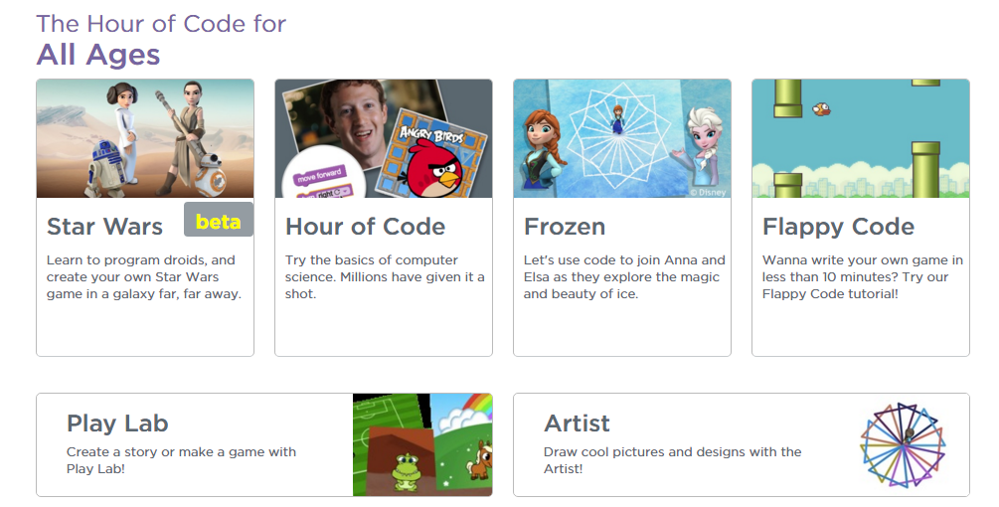
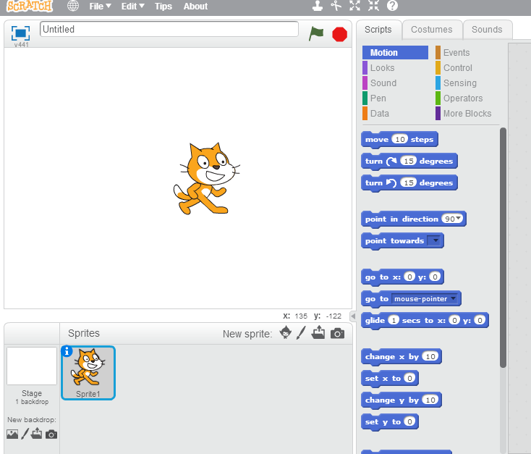
Locate Resources
Link to popular coding tutorial sites for all ages
Share progress, see what your peers are using
Review sites on forums
Above: Code.org’s Code Studio for students
Left: Scratch.mit.edu’s interactive program creation platform

Slide 6
Features for All Ages
Customize profile with HTML/CSS
Share progress on sites like Codeacademy and Code.org
Link GitHub account to share code
Form groups with similar interests
RSVP to Girls Who Code events

Slide 7
Uses for WiCC
Create events and challenges for girls
Allows girls to get involved remotely
Generates / maintains CS interest by placing focus on peer network

Slide 8
Scalability
Groups feature makes site accessible to GWC chapters nationwide
No need to join a group for girls without a GWC chapter
Reach out to coding tutorial websites for marketing/ advertisement

